Slide 1
Complete Guide to the MIPS Instruction Set
邹旭
2018.8.19

Slide 2
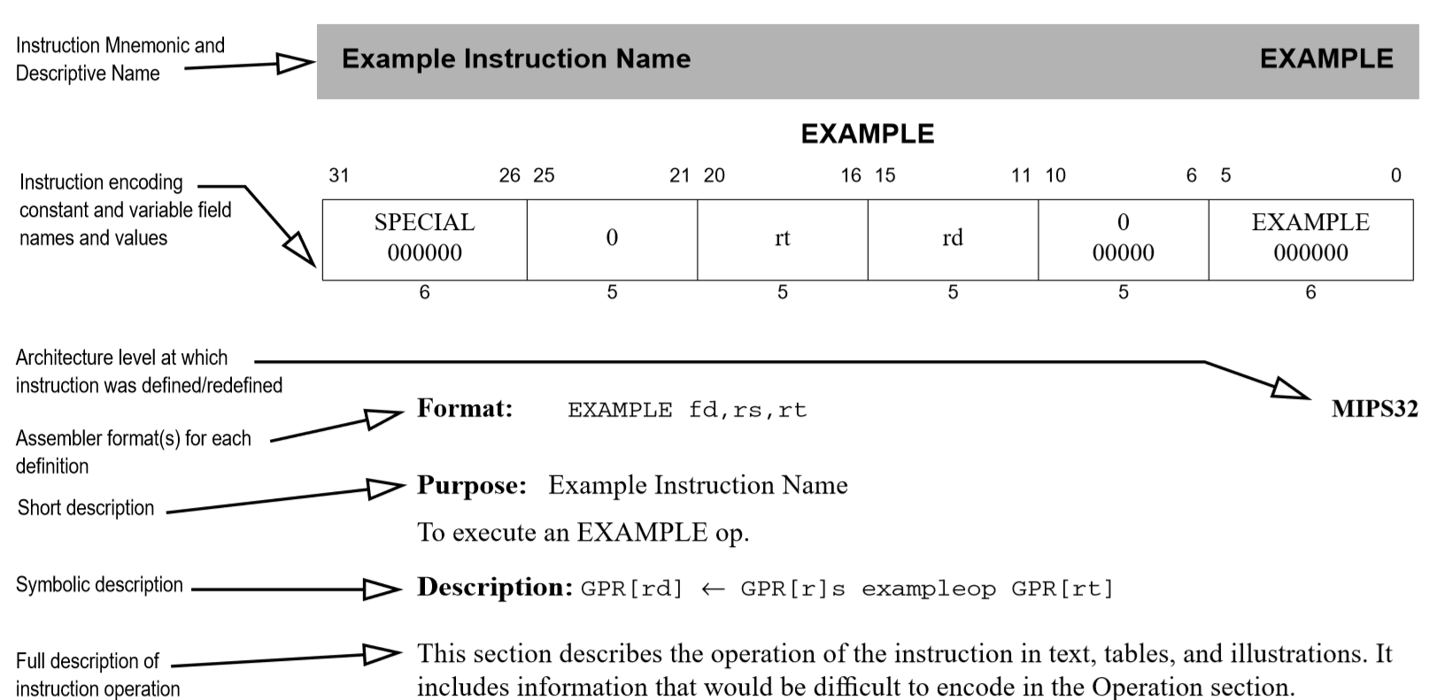
Instruction description

Slide 3
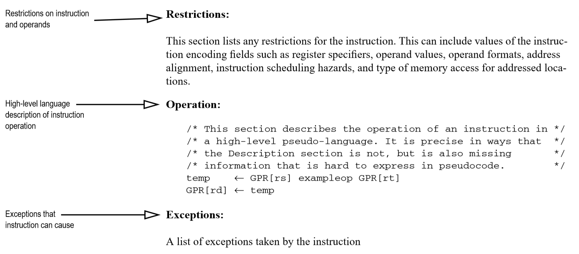
Instruction description

Slide 4
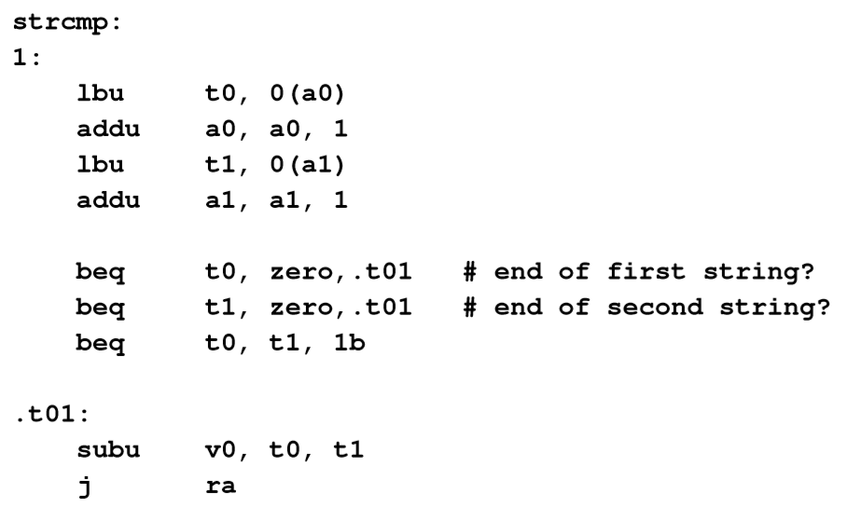
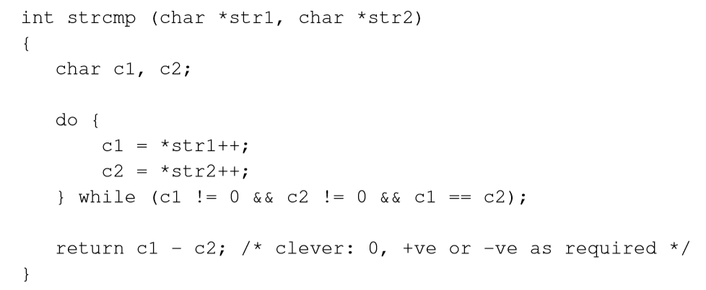
C function in assembly code

Slide 5
Assembly instructions
Assembly format
Function
Machine instructions generated
abs d, s
d = s < 0 ? –s : s;
sra $at, s, 31 # tmp = 32{sign(s)}
xor d, s, $at # d = s | tmp
subu d, d, $at # d = d – tmp

Slide 6
Inventions used in instruction table
wrod | used for | word | used for
s, t | Operends | at | Temporary register, $1
d | Result | zero | $0
j | “Immediate” constant | ra | Return address, $31
label | Entry point of Instructions stream | hilo | Double-precision integer multiply
shf | Amount of shift operation, in bits shift/rotate/extract/insert | cd | Coprocessor register written by instruction
sz | Size of field being manipulated, extract/insert | cs | Coprocessor register read by instruction
offs | PC-related word offset | exception(cause) | Take a CPU trap
addr | Data address, load/store | const31…16 | Bits 31-16 of binary number const

Slide 7
Confusing things
suffix ‘u’ # read as “unsigned”
Overflow trap versus no trap # add vs addu
Set if # slt vs sltu for negative numbers
Multiply and divide # mult vs multu lo overflows into hi
# div vs divu consider 0xffff fffe divided by 2
Partial register loads # zero-extending vs sign-extending
Divide mnemonics
div d, s, t # divo
div zero, s, t # divd

Slide 8
Instructions added in MIPS32/64 release 2
Regular instructions
Extract/insert bitfield
Word reorganization – rotate, byte-extend, and swap assistance
Instructions for FPU
Read hardware register
Make newly written instructions visible
Privileged instructions
Atomic interrupt disable/enable
Shadow register support

Slide 9
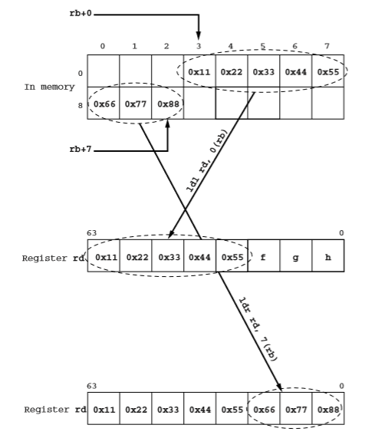
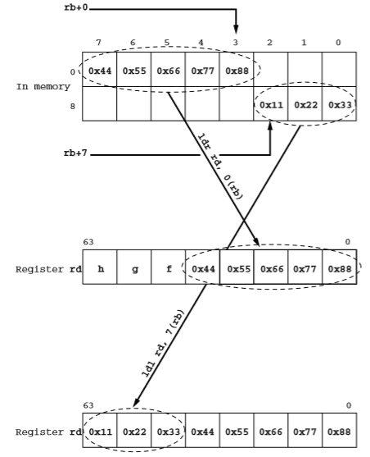
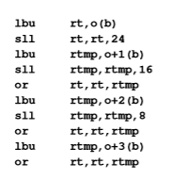
Peculiar instructions and their purposes
ldl / ldr : unaligned load and store

Slide 10
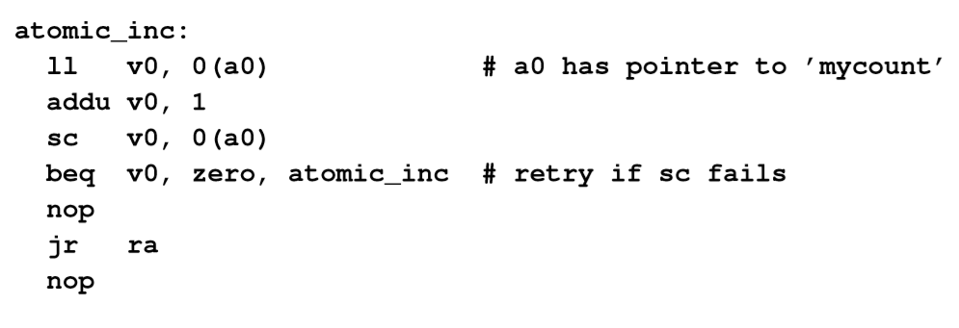
Peculiar instructions and their purposes
ll / sc : provide atomic operations

Slide 11
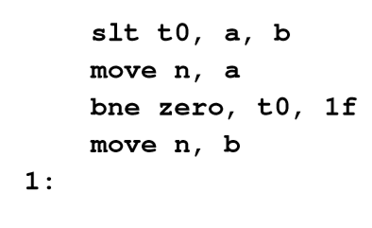
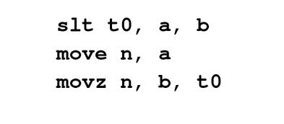
Peculiar instructions and their purposes
Conditional move instructions
Conditional branch is bad for pipeline ficiency
n = (a < b) ? a : b;

Slide 12
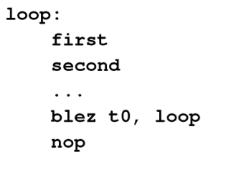
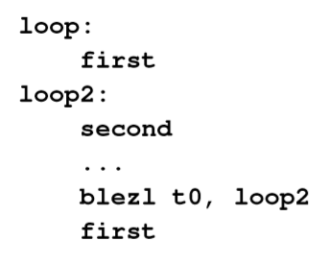
Peculiar instructions and their purposes
Branch-likely
Eliminating nops

Slide 13
Peculiar instructions and their purposes
Integer/Floating point multiply-accumulate and multiply-add instructions
Used in multimedia algorithms. Eg: JPEG decorder
mad/madd fd, fr, fs, ft # fd = fr + fs * ft
Multiple FP condition bits
Prefetch
pref provides a way for a program to signal the cache/memory system that data is going to be needed soon

Slide 14
Peculiar instructions and their purposes
Sync
You are guaranteed that all load/stores initiated before the sync will be seen before any load/store initiated afterward
Hazard barrier Instructions
ehb; jr.hb, jalr.hb
Sysnci
Read hardware register

Slide 15
Instruction encodings

Slide 16
Instructions by function group
No–op
nop # sll zero, zero, 0
Snop # sll zero, zero, 1
Register/register moves: widely used, if not exciting; includes conditional moves
move # or $zero; addu zero
movf, movt # floating-point condition code
movn, movz #
Load constant: integer immediate values and addresses
La # load the address of some labeled location
Li # load constant immediate
Lui # load upper immediate

Slide 17
Instructions by function group
Arithmetical/logical instructions
Add
Miscellaneous arithmetic (abs, neg)
Bitwise logical instruxtions
Shifts and rotates
Set if …
Integer multiply, divide, and remainder
Integer multiply-accumulate

Slide 18
Instructions by function group
Loads and stores
Jumps, subroutine calls, and branches
Breakpoint and trap
CP0 functions: instructions for CPU control
Floating point
Limited user-mode access to “under the hood” features: synci, rdhwr, synci

